Slide 1

推荐学习网站
https://www.nowcoder.com

Slide 2

专项练习

Slide 3
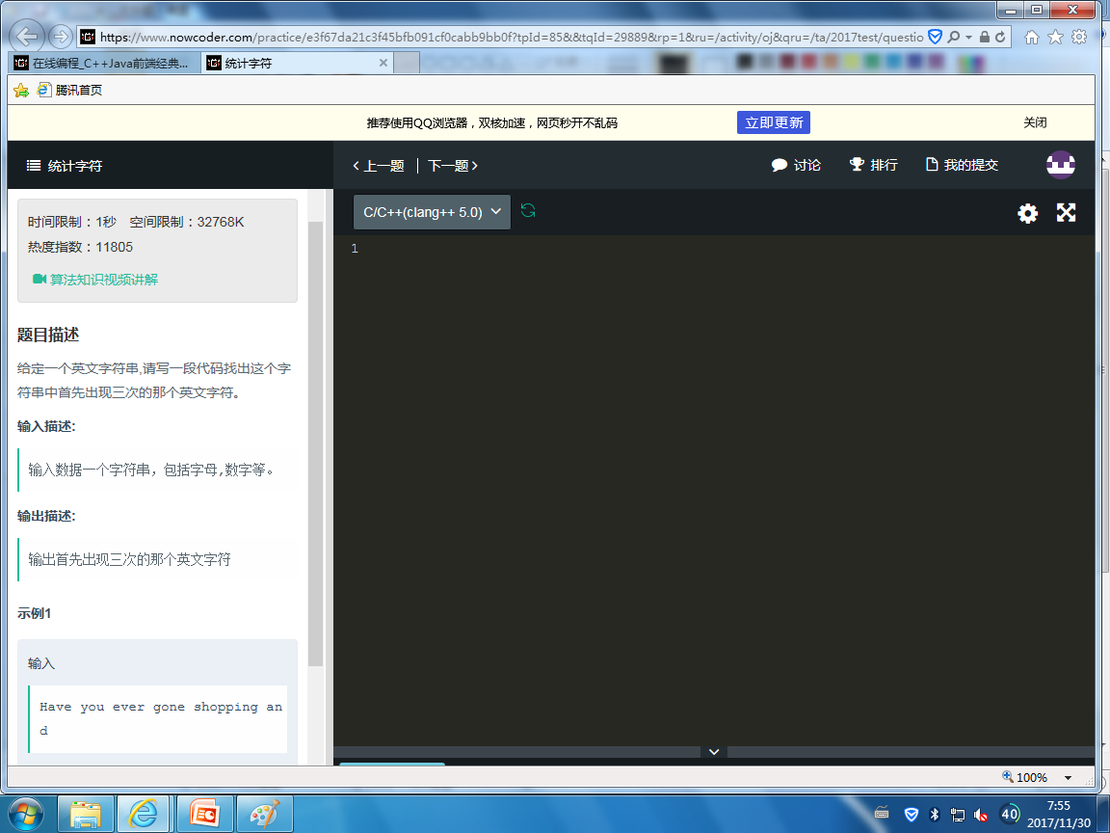
例题
https://www.nowcoder.com/questionTerminal/e3f67da21c3f45bfb091cf0cabb9bb0f

Slide 4
#include <stdio.h>
#include <string.h>
#define MAXLEN 1000
#define MAX 255
char solve(char *pstr)
{ int count[MAX],i;
for (i=0;i<MAX;i++) count[i]=0;
for (i=0;pstr[i]!='\0';i++)
{ count[pstr[i]]++;
if (count[pstr[i]]==3) return pstr[i];
}
return 0;
}
int main()
{ char str[MAXLEN];
scanf("%s",str);
printf("%c",solve(str));
return 0;
}
错误

Slide 5
#include <stdio.h>
#include <string.h>
#define MAXLEN 1000
#define MAX 255
char solve(char *pstr)
{ int count[MAX],i;
for (i=0;i<MAX;i++) count[i]=0;
for (i=0;pstr[i]!='\0';i++)
{ if ((pstr[i]>='a' && pstr[i]<='z') ||
(pstr[i]>='A' && pstr[i]<='Z'))
{ count[pstr[i]]++;
if (count[pstr[i]]==3) return pstr[i];
}
}
return 0;
}
int main()
{ char str[MAXLEN];
scanf("%s",str);
printf("%c",solve(str));
return 0;
}
错误

Slide 6
#include <stdio.h>
#include <string.h>
#define MAXLEN 1000
#define MAX 255
char solve(char *pstr)
{ int count[MAX],i;
for (i=0;i<MAX;i++) count[i]=0;
for (i=0;pstr[i]!='\0';i++)
{ if ((pstr[i]>='a' && pstr[i]<='z') ||
(pstr[i]>='A' && pstr[i]<='Z'))
{ count[pstr[i]]++;
if (count[pstr[i]]==3) return pstr[i];
}
}
return 0;
}
int main()
{ char str[MAXLEN];
gets(str);
printf("%c",solve(str));
return 0;
}
正确

Slide 7
